Slide 1
Case Study – Hot Pot
Trainer name: Mr. Javeed Mohammed
Trainee name: Sandhya C

Slide 2
About Hot Pot
It is an online food ordering website
It has 2 role-based dashboards, with respective services
User with Customer role can access customer-dashboard and do the following:
View all Restaurants
View Restaurant Menu
Add menu item to cart
Delete menu item from cart
Clear cart

Slide 3
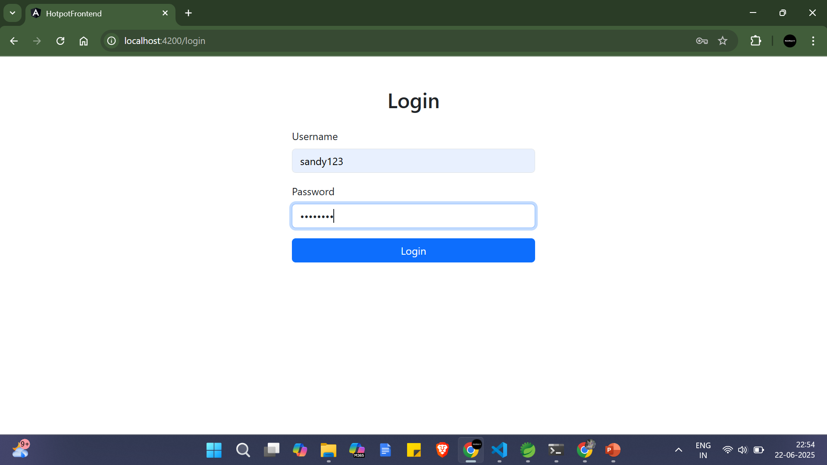
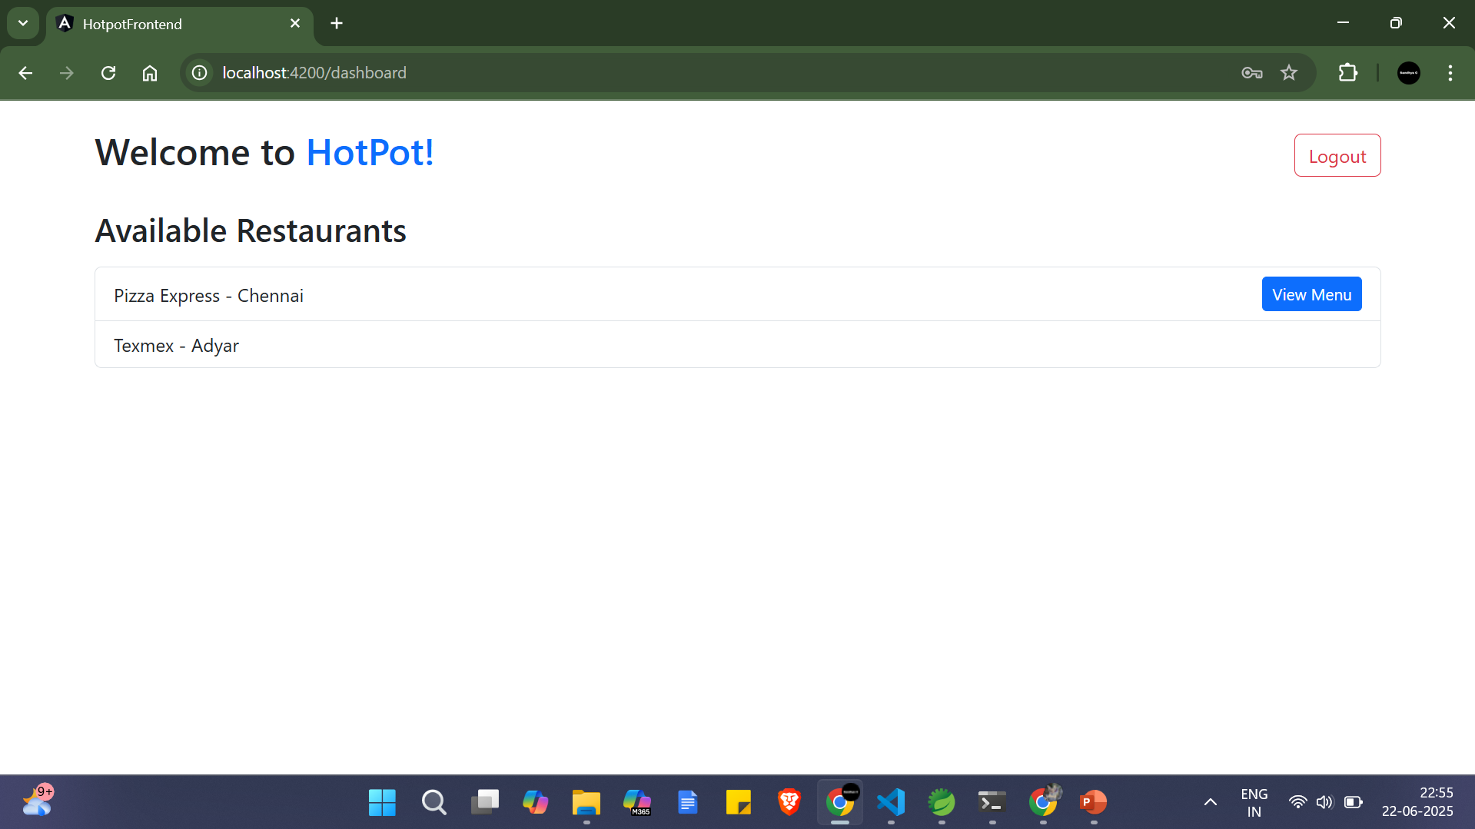
Screenshots of output

Slide 4
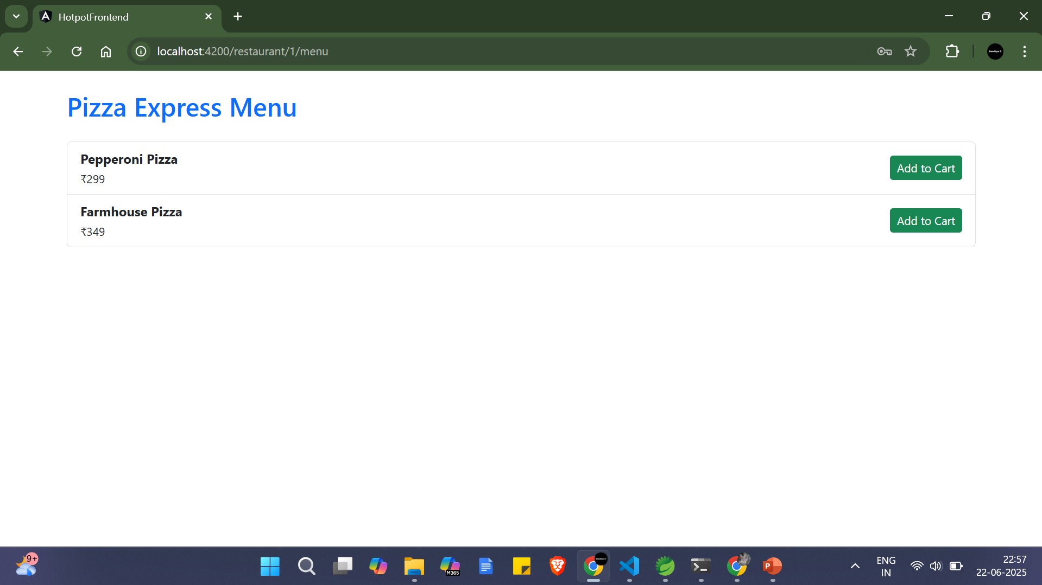
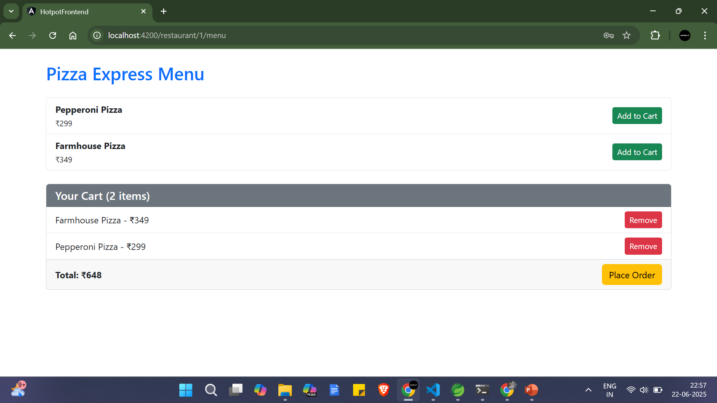
Screenshots of output

Slide 5
About Hot Pot
When user has Admin role, they are navigated to Restaurant dashboard
Users with Admin role can do the following:
Add restaurant
Update existing restaurant
Delete existing restaurant
View restaurant by id

Slide 6

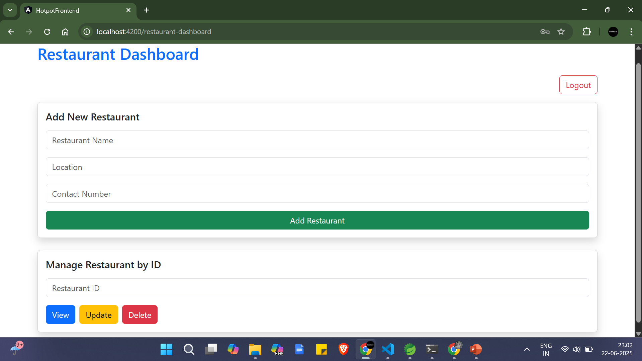
Screenshots of output

Slide 7
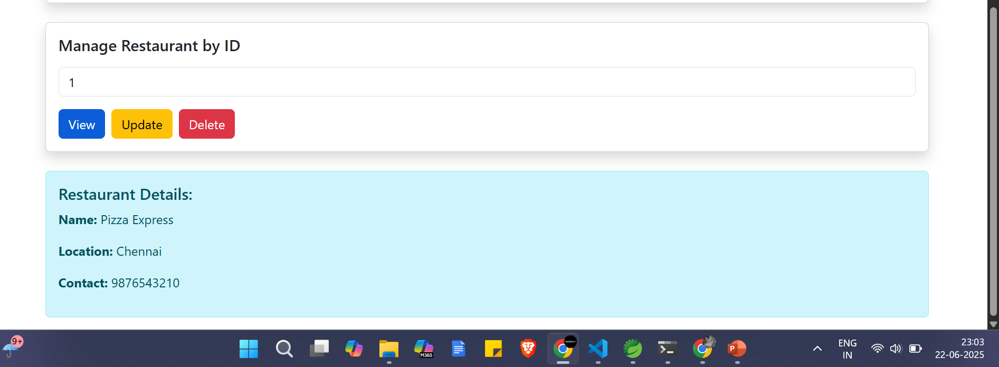
Screenshots of output

Slide 8
Technology used
Java 17
Spring Boot
MySQL DB
Angular 15

